Slide 1
UNIVERSITY CLUB PORTAL​
Your wish, we'll make it come true online.

Slide 2
Eva Islam
2020-1-60-273
Computer Science and Engineering
Sajib Khan
2020-1-60-186
Computer Science and Engineering

Slide 3
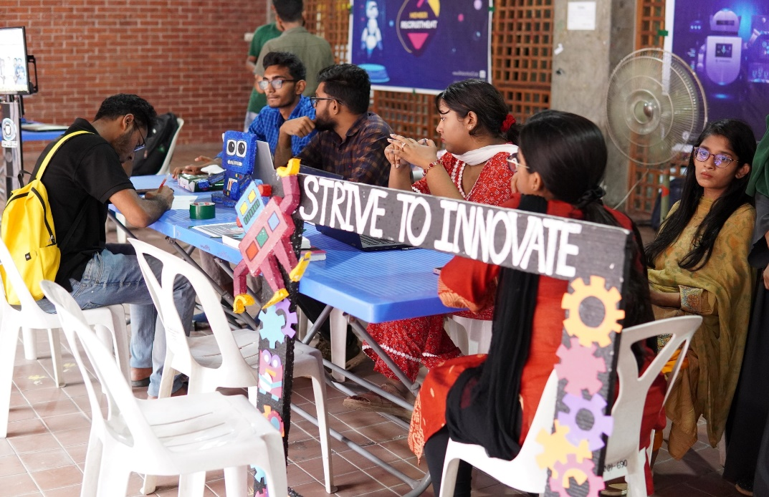

Introduction
Our goal is to make it simple for people to apply to the university club of their choice. We are hoping to create an online university club gateway where any student may look up and join their preferred club without having to fill out any paperwork. As for posting valuable notices on the site, club administrators may do so.

Slide 4

OBJECTIVE
To make our system more paperless
Esay register
Everything in one place
Saving time of physical work

Slide 5
OBJECTIVE
To make our system more paperless
Esay register
Everything in one place
Saving time of physical work

Slide 6
OBJECTIVE
To make our system more paperless
Esay register
Everything in one place
Saving time of physical work

Slide 7
OBJECTIVE
To make our system more paperless
Esay register
Everything in one place
Saving time of physical work

Slide 8
KEY FEATURES
01
Students can login with their university email or any google account.

Slide 9
KEY FEATURES
01
Students can login with their university email or any google account.
02
Instructions how to apply for any desire club& students can apply for a club with filling up a form.

Slide 10
KEY FEATURES
01
Students can login with their university email or any google account.
02
Instructions how to apply for any desire club & students can apply for a club with filling up a form.
03
A club president can approve the request and send a confirmation mail to approve student.

Slide 11
KEY FEATURES
01
Students can login with their university email or any google account.
02
Instructions how to apply for any desire club & students can apply for a club with filling up a form.
03
A club president can approve the request and send a confirmation mail to approve student.
04
An admin can change the rule of a club & can post any notice on their page so can students can see it.

Slide 12
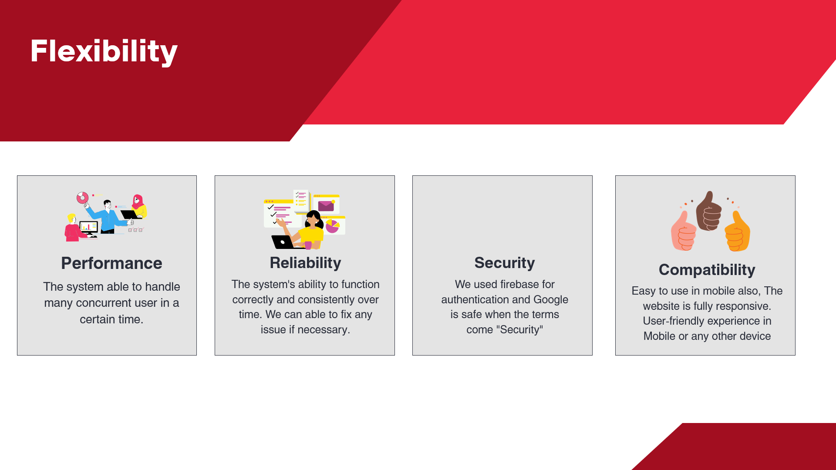


Slide 13
Conclusion
Every student will have no trouble learning about the university clubs. time-saving, and paperwork is no longer a nuisance. Any wish can be satisfied online.

